Slide 1
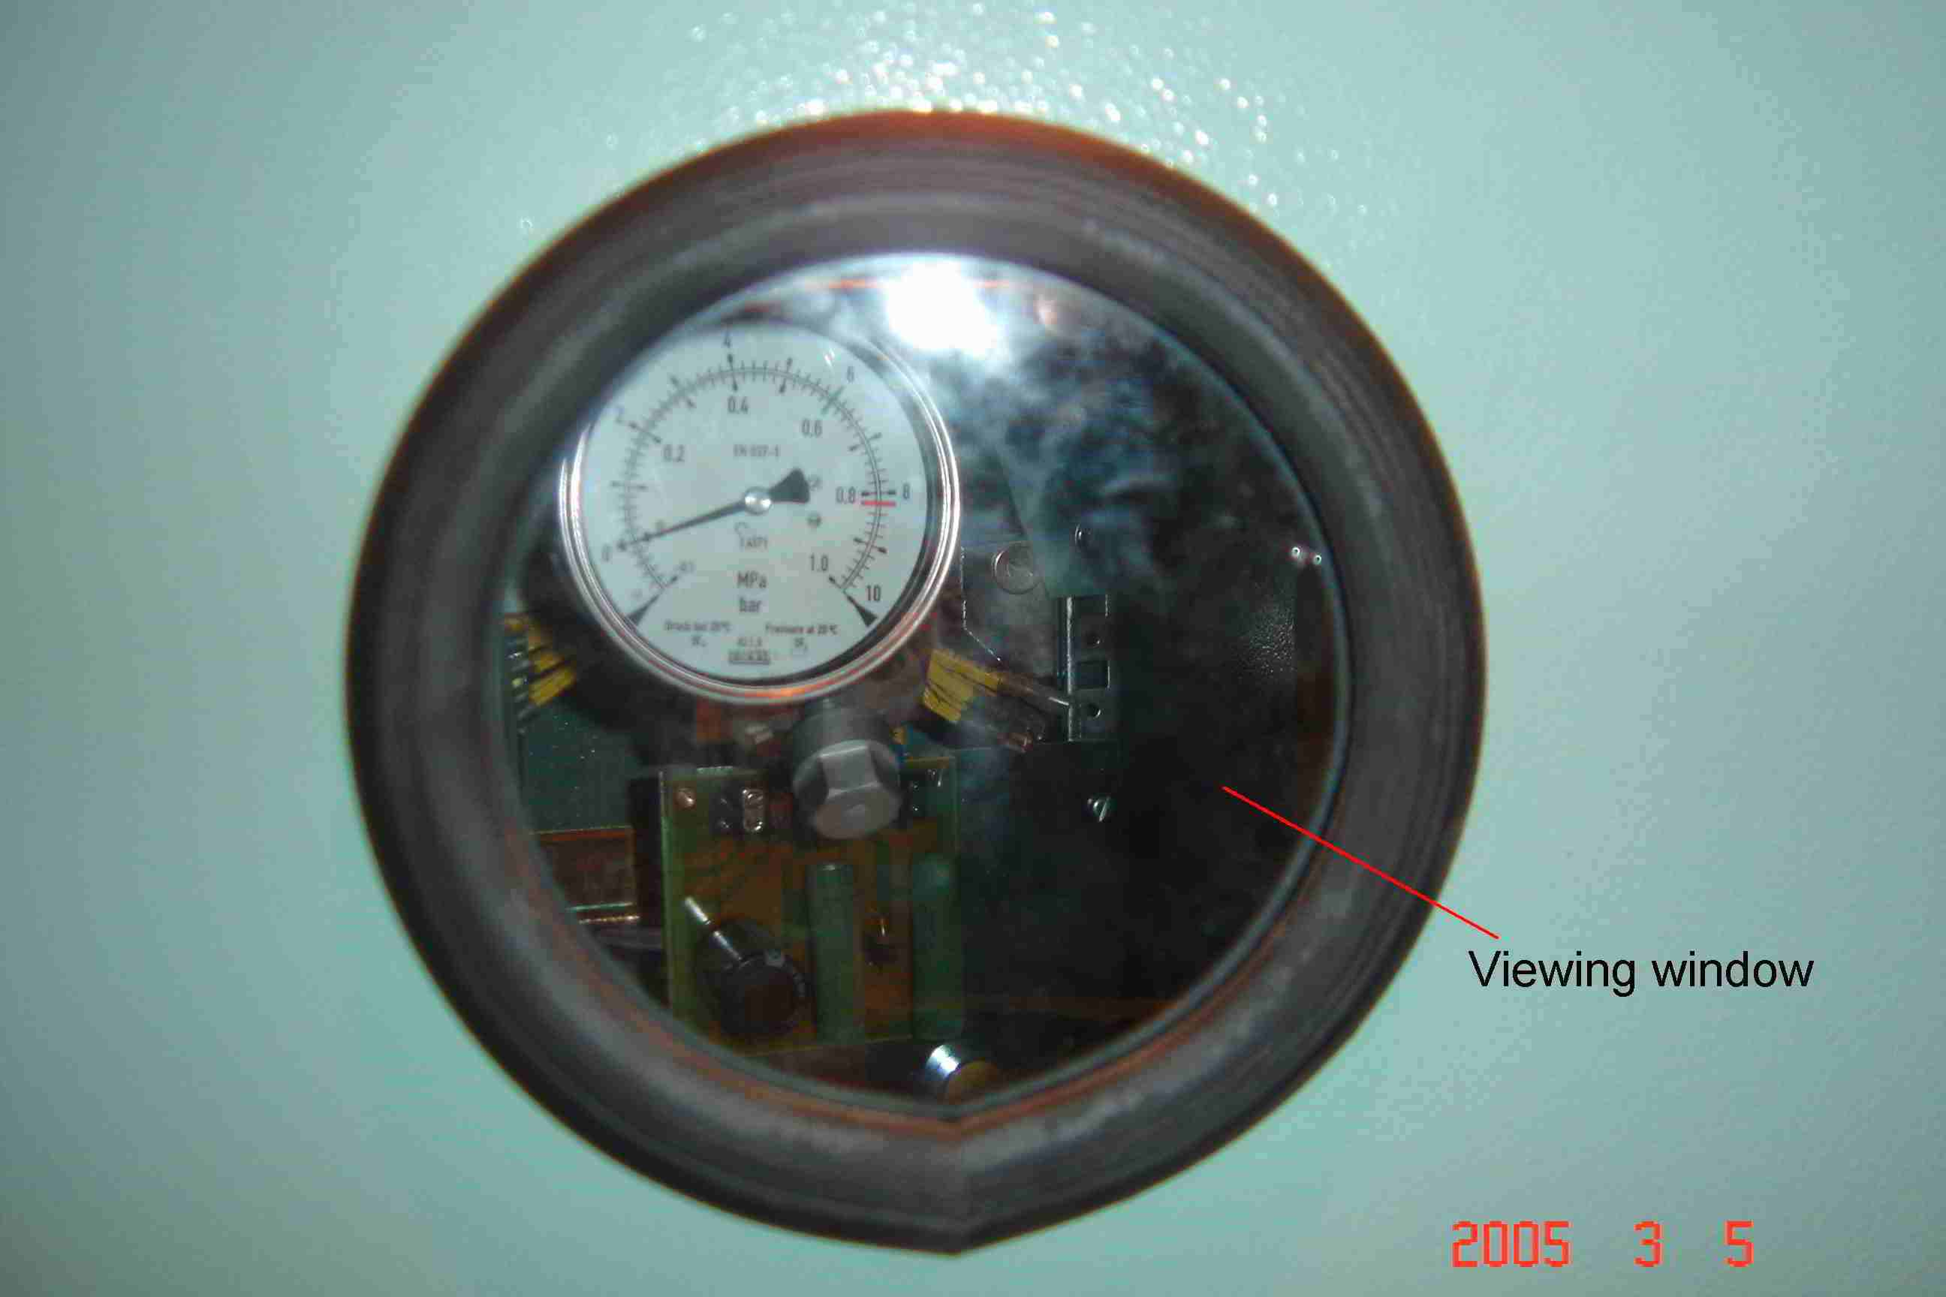
SIEMENS
HVCB SPARES
Viewing window Glass & Gasket, 72.5KV, 145KV & 245KV CB
S4799248001

